Slide 1
Barack Obama Elementary School’s April Students of the Month that displayed the I.B. Profile Trait, “Knowledgeable”

Slide 3
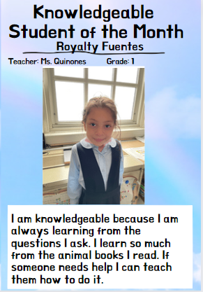
Royalty Fuentes
Ms. Quinones ​
​
Grade 1

Slide 4
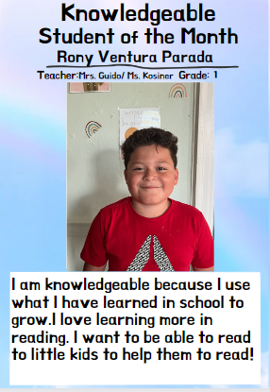
Rony Ventura Parada
Mrs. Guido ​
& ​
Ms. Kosiner ​
​​​
Grade 1​​​

Slide 6
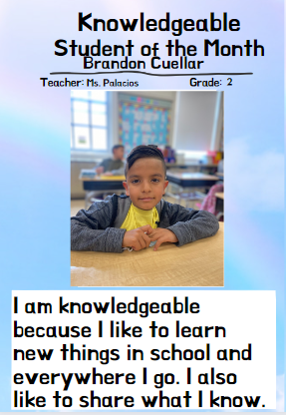
Brandon Cuellar
Ms. Palacios​
​​​
Grade 2

Slide 7
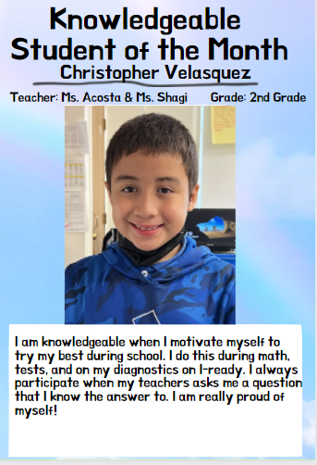
​
​
​Christopher Velasquez
Ms. Acosta ​
& Ms. Shagi ​
​
Grade 2​​​

Slide 8
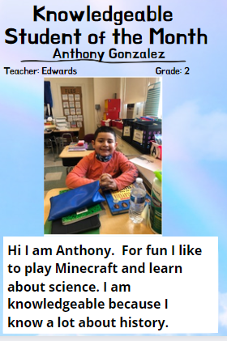
Anthony Gonzalez
Ms. Edwards ​
​
Grade 2​​​

Slide 9
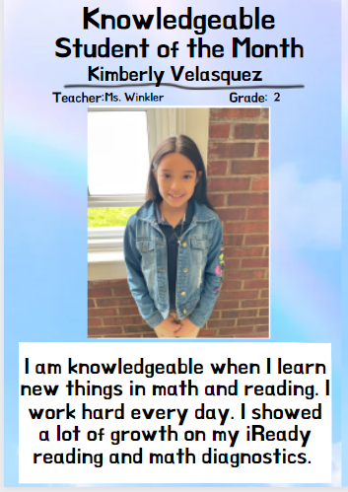
Kimberly Velasquez
Ms. Winkler ​
​
Grade 2​​

Slide 11
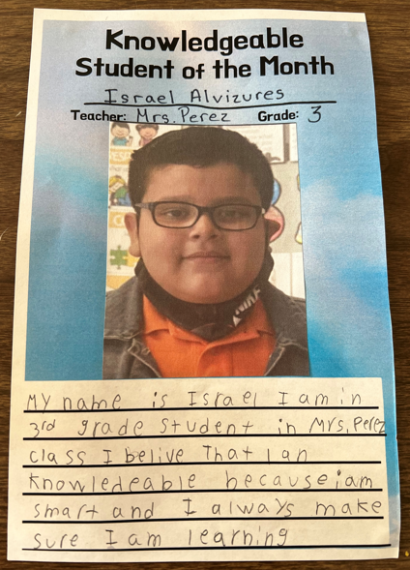
​
Israel Alvizures
Mrs. Perez ​
​
​​Grade 3​​​

Slide 12
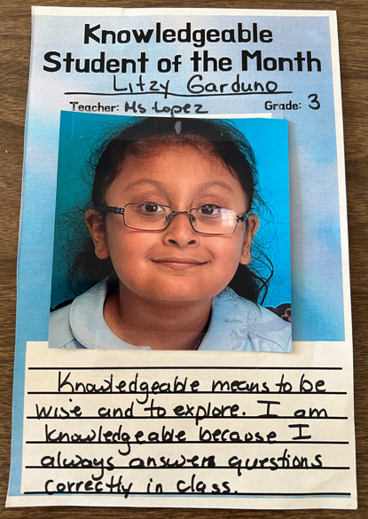
​
Litzy Garduno
Ms. Lopez​
​
​​Grade 3​​​

Slide 13
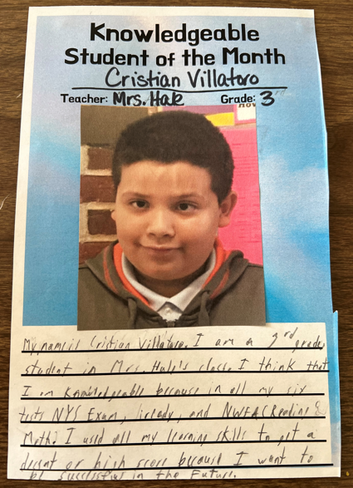
​
​​
Cristian Villatoro
Mrs. Hale​
​​​
Grade ​3​

Slide 14
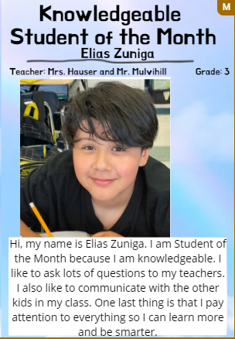
Elias Zuniga
Mrs. Hauser ​
and ​
Mr. Mulvihill ​
​
Grade 3​

Slide 16
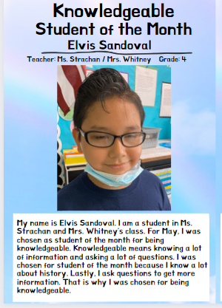
Elvis Sandoval
Ms. Strachan
& ​
Mrs. Whitney ​
​
​​Grade 4​​

Slide 17
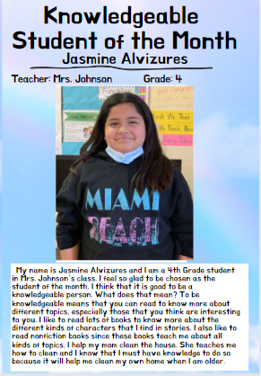
Jasmine Alvizures
Mrs. Johnson ​
​​​
Grade 4

Slide 18
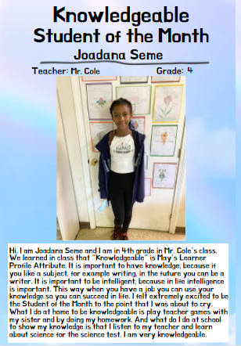
Joadana Seme
Mr. Cole ​
​​​
Grade 4

Slide 20
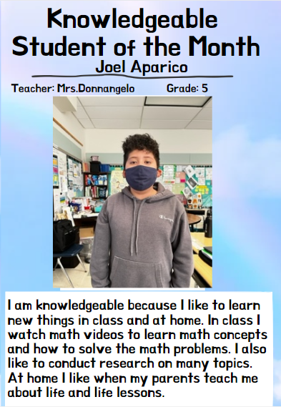
Mrs. Donnangelo​
​
Grade 5​​​

Slide 21
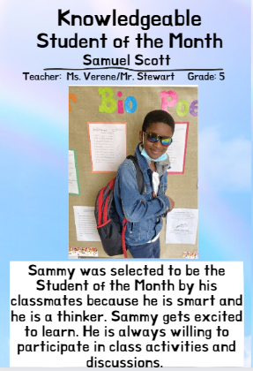
​
​​Samuel Scott
​
Ms. Verene ​
​
Grade 5​

Slide 22
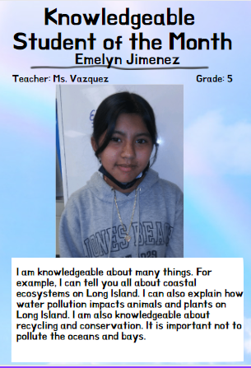
​
​​
​Emelyn Jimenez
Ms. Vazquez
​
Grade 5​

Slide 23
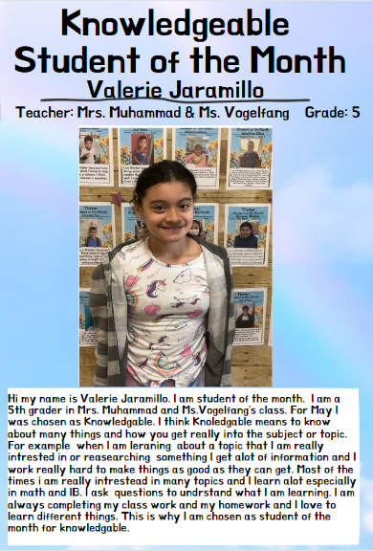
​
​​Valerie Jaramillo
Mrs. Muhammad ​
and ​
Ms. Vogelfang ​
​
​​Grade ​5​

Slide 24
Teacher: ​
Mr. Jacobs​​​

Slide 25
Physical Education​​​ Students of the Month​​​
1st Grade:​ Matt Matamoros
2nd Grade: ​Eshal Husain
​3rd Grade:​ James Rivas Lanza
4th Grade: ​​Jermere Clinkscaleas
​5th Grade: ​Diego Martinez Aparicio

Slide 26
Teacher: ​​
Mr. Taylor

Slide 27
Music​​​ Students of the Month​​​
1st - Alisson Antunez 2nd - Jonathan Ulloa 3rd - Dayli Miranda 4th - Alessandra Ramos 5th - Johann Villatoro-Paz

Slide 28
Teacher: ​​
Mrs. Randazzo

Slide 29
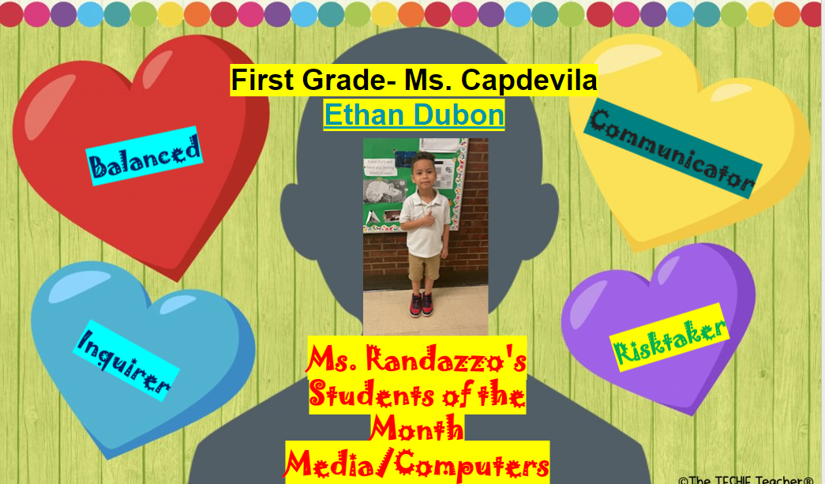

Slide 30
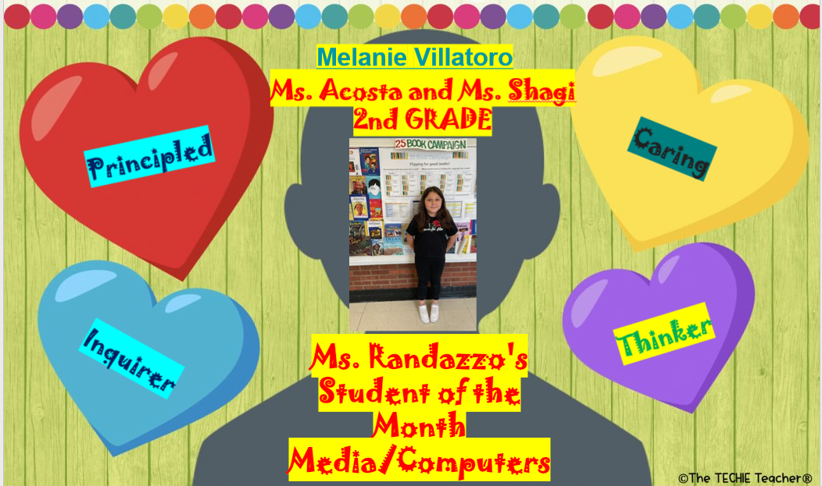

Slide 31
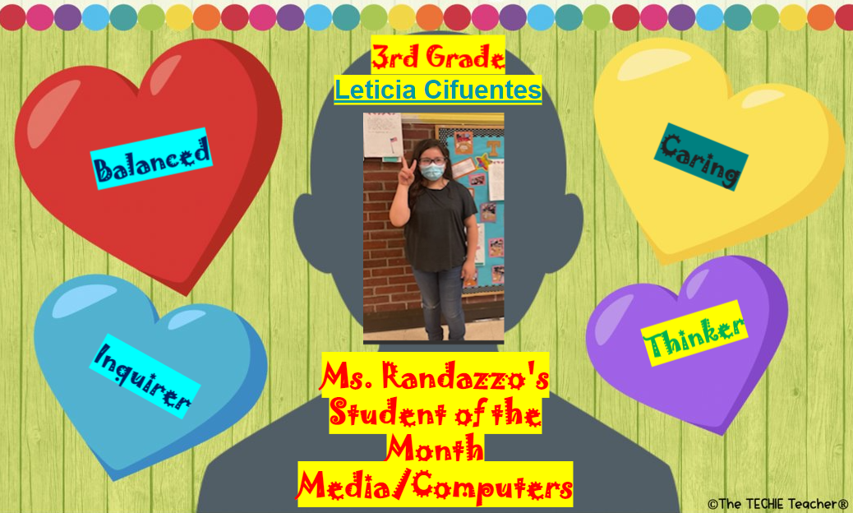

Slide 34
June 2022 Students of the Month
Teacher: Ms. K Chester

Slide 35
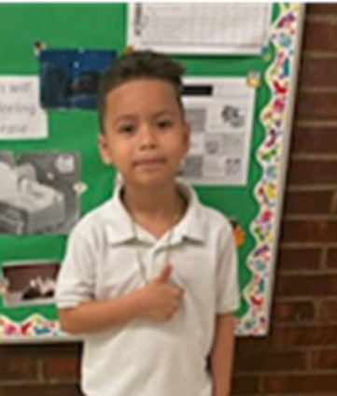
Grade 1 June 22' Student of the Month

Slide 36
Grade 2 June 22' Student of the Month

Slide 37
Grade 3 June 22' Student of the Month

Slide 38
Grade 4 June 22' Student of the Month

Slide 39
Grade 5 June 22' Student of the Month

Slide 40
Foreign Language at the ​
Elementary School (FLES)​​​
Teacher: ​​
Ms. Moran​​​

Slide 41
1st Grade:​ Matthew Portillo Araniva (Mrs.Guido/Ms.Kosiner)
2nd Grade: Brandon Cuellar
(Ms. Palacios)
​
3rd Grade: Gilson Villatoro Paz
(Mrs. Hale)
4th Grade: Bridgette Contreras Diaz
(Ms. Gallagher)
​
5th Grade:​ Judith Requeno Garcia
(Ms. Vazquez)

